Slide 1

Self-Interested Agents and Utility Theory (2)
Chris Kiekintveld

Slide 2
Why Utility?
Why would anyone argue with the idea that an agent’s preferences could be described using a utility function as we just did?

Slide 3
Why Utility?
Why would anyone argue with the idea that an agent’s preferences could be described using a utility function as we just did?
why should a single-dimensional function be enough to explain preferences over an arbitrarily complicated set of alternatives?
Why should an agent’s response to uncertainty be captured purely by the expected value of his utility function?
It turns out that the claim that an agent has a utility function is substantive.

Slide 4
Preferences Over Outcomes
If o₁ and o₂ are outcomes
o₁ ≤ o₂ means o₁ is at least as desirable as o₂
read this as “the agent weakly prefers o₁ to o₂ ”
o₁ ∼ o₂ means o₁ ≤ o₂ and o₂ ≤ o₁.
read this as “the agent is indifferent between o₁ and o₂ .”
o₁ > o₂ means o₁ ≤ o₂ and o₂ ≤ o₁
read this as “the agent strictly prefers o₁ to o₂ ”

Slide 5
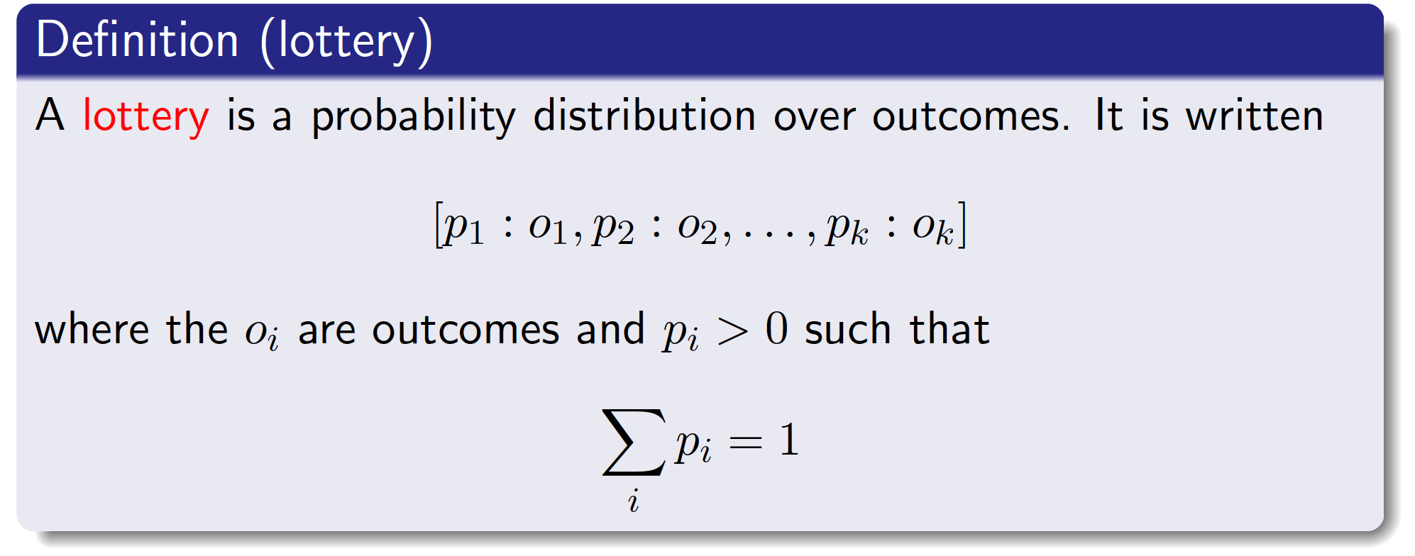
Lotteries
An agent may not know the outcomes of his actions, but may instead only have a probability distribution over the outcomes.
The lottery specifies that outcome o_{i} occurs with probability p_{i}.
We will consider lotteries to be outcomes.

Slide 6
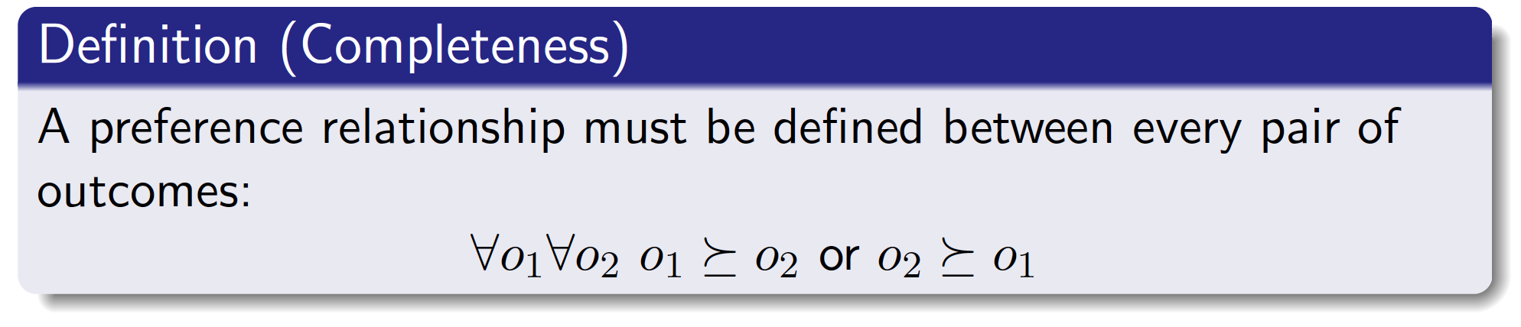
Preference Axioms: Completeness

Slide 7
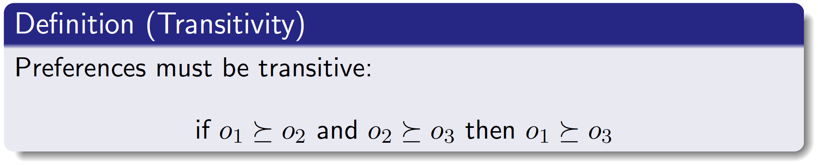
Axioms: Transitivity
This makes good sense:
otherwise o₁ ≤ o₂ and o₂ ≤ o₃ and o₃ > o₁.
An agent should be prepared to pay some amount to swap between an outcome they prefer less and an outcome they prefer more
Intransitive preferences mean we can construct a “money pump”!

Slide 8
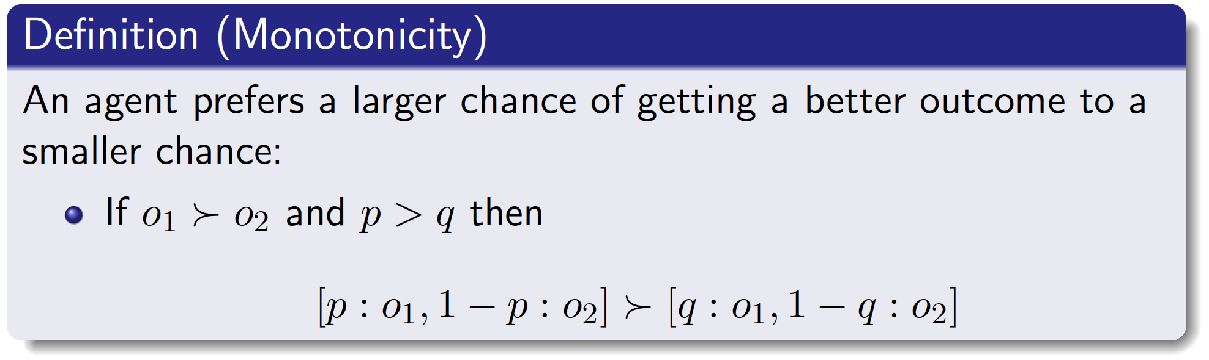
Axioms: Monotonicity

Slide 9
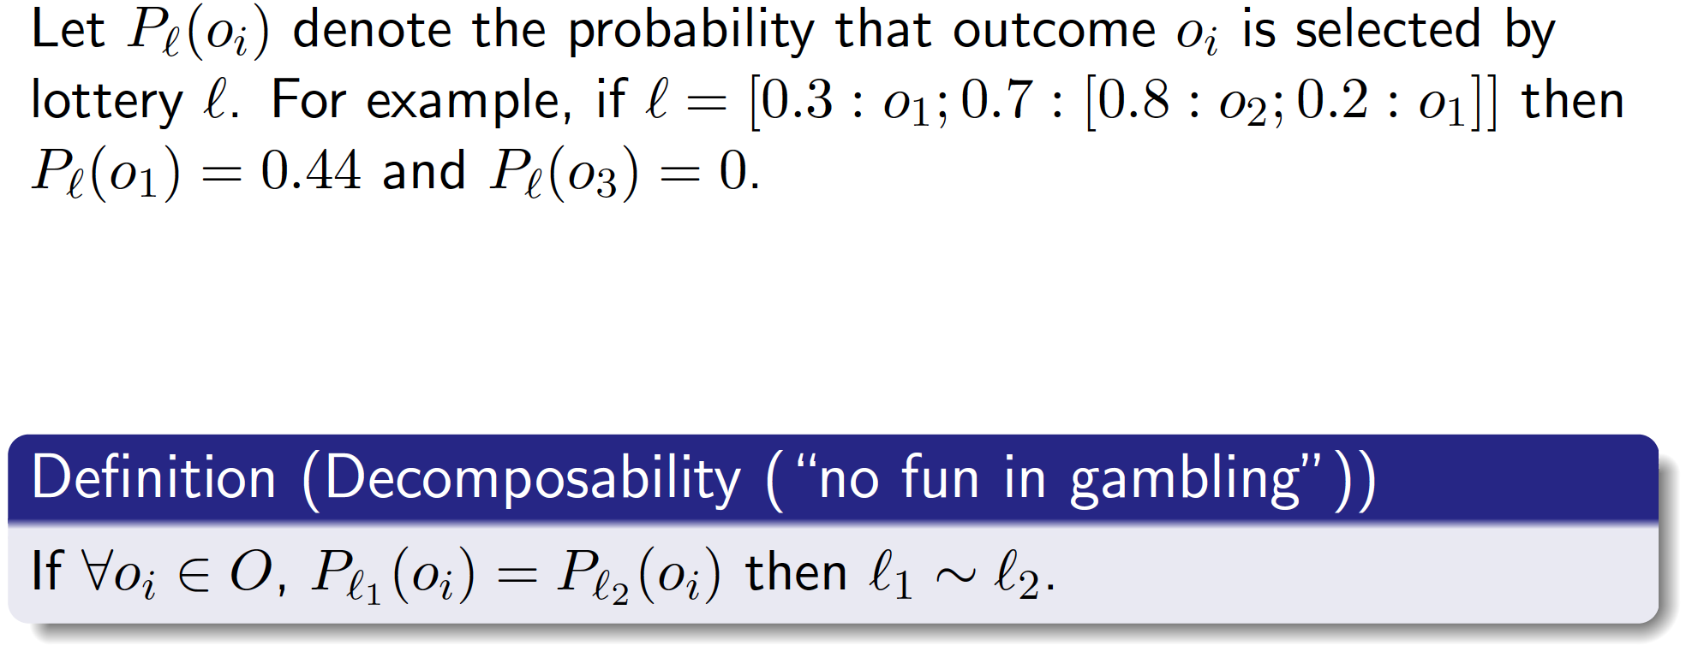
Axioms: Decomposability

Slide 10
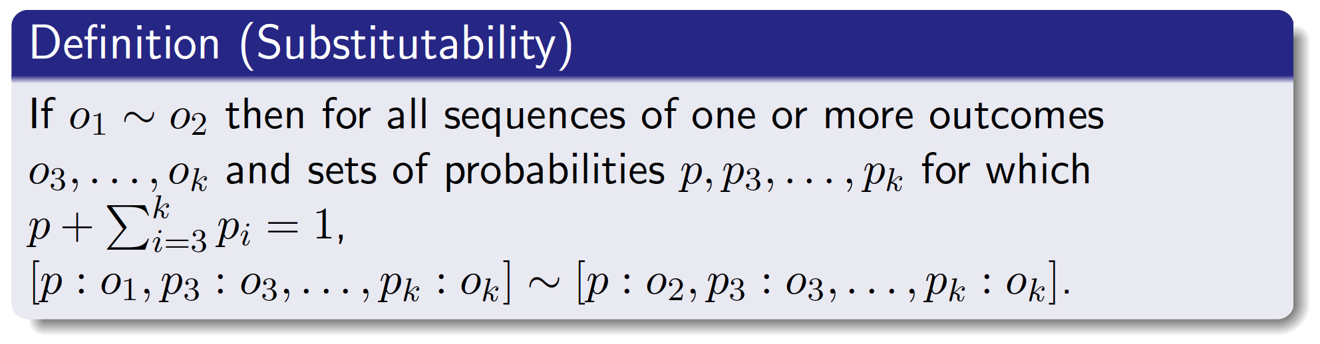
Axioms: Substitutability

Slide 11
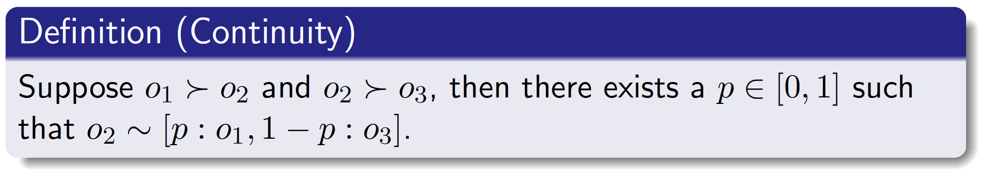
Axioms: Continuity

Slide 12
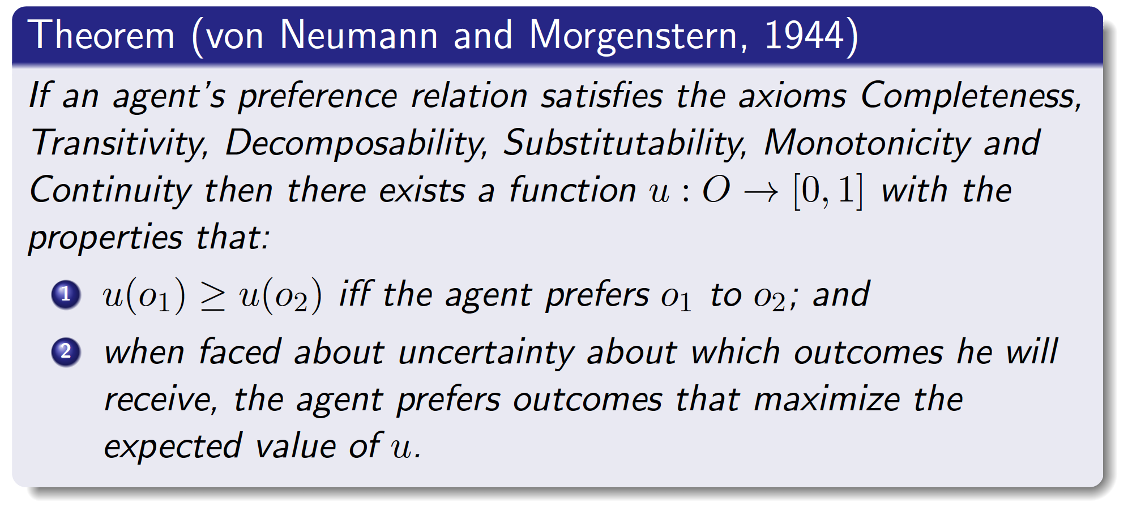
”Rational” Preference Imply Utilities
Proof idea: define utilities of best and worst outcomes, then set the utilities for other outcomes based on indifference in a lottery between those two

Slide 13
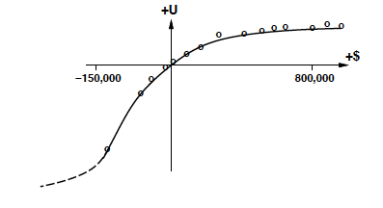
Utilities and Money
Money does NOT behave as a utility function
Most people are risk averse and prefer lotteries with more certain outcomes even if they have a higher expected value
A typical empirical utility curve looks something like:

